Slide 1
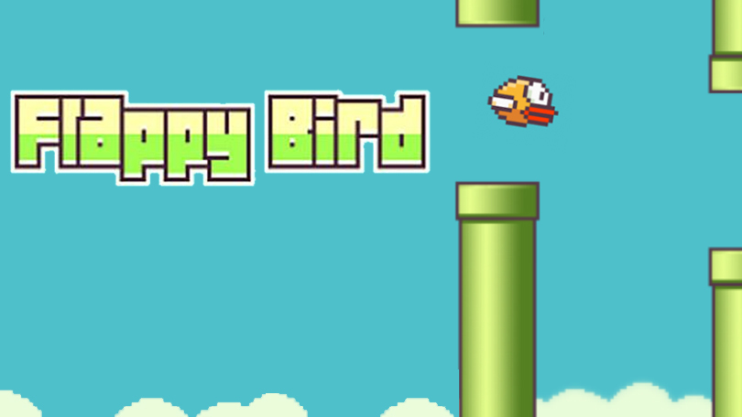
FLAPPY BIRD IN PYTHON
Rohan das – aritri Chowdhury – hritika dey – ishak debnath

Slide 2
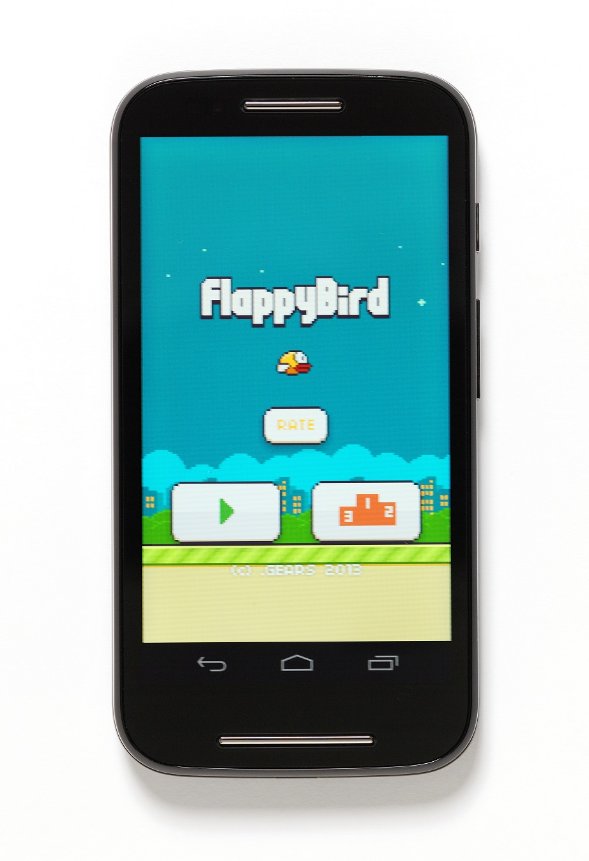
Abstract
For this project, we chose to create the FLAPPY BIRD GAME which we used to play in old Android mobiles.
The purpose of the project was to gather knowledge about different modules in Python Language, their different functions and how to use them.
Using standard functions we were able to develop and implement most of the features, though it is not exactly perfect. We’ll discuss the drawbacks of the application in this report itself.

Slide 3
Application Details
Now we’ll see the application details…..

Slide 4
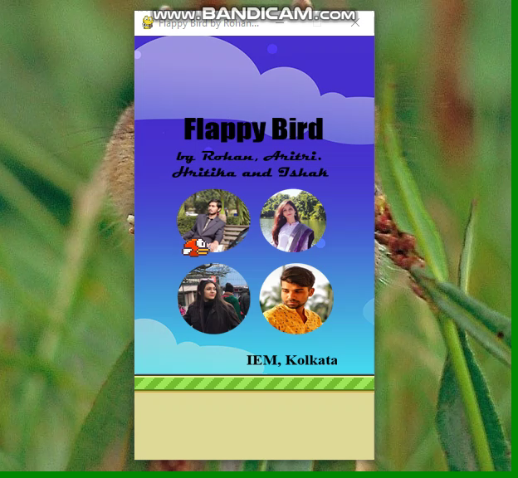
Here is the Game
Here is a video of the gameplay.

Slide 5
Difficulties Faced and Conclusion
The main problem of making the game is that, we’ve to tune a lot to get the perfect position of the GAME_SPRITES. The Python Programming Language makes the simple game development process very easy. The pygame package makes it very much easy.
It was an exciting project to work on and there is a lot I learnt from it, above and beyond its original scope. I was able to study and train myself on development in an environment that was almost completely foreign to me, which I believe I have been reasonably successful with.
To get the source code visit: https://github.com/rohan26062001/Flappy-Bird-in-Python

Slide 6
Acknowledgement
We would like to express our special thanks of gratitude to my teacher Moumita Ma'am as well as our principal Swagatam Sir who gave us the golden opportunity to do this wonderful project on the topic, which also helped us in doing a lot of research and we came to know about so many new things we are really thankful to them.

Slide 7
Members of this Project
Rohan Das
Author
Sec - A
Roll – 14
Email
Aritri Chowdhury
Co-Author
Sec - B
Roll – 97
Email
Hritika Dey
Co-Author
Sec- B
Roll – 93
Email
Ishak Debnath
Co-Author
Sec - A
Roll – 46
Email

